Slide 1
Binning in Tibco Spotfire

Slide 2
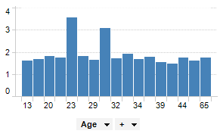
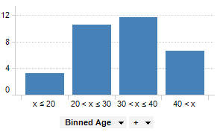
General information
Binning is a way to group a number of more or less continuous values into a smaller number of "bins". For example, if you have data about a group of people, you might want to arrange their ages into a smaller number of age intervals. Numeric columns can also be temporarily grouped by right-clicking on a column selector and clicking Auto-bin Column.

Slide 3
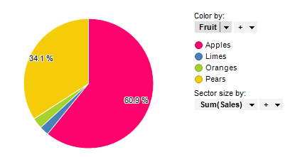
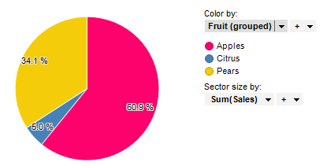
Example of binning categorical data
We can bin not only numeric, but also categorical data. It can be seen on pictures below, here we got 4 categories of fruits: apples, limes, oranges and pears. But what if we're not interested in so detailed information about oranges and limes? Then we can bin it in one category called Citrus.

Slide 4
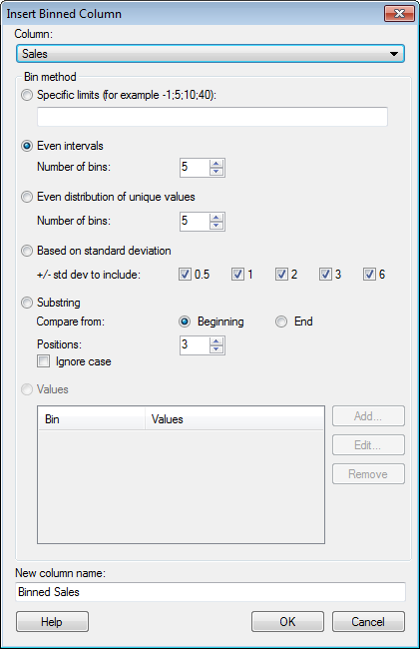
How to add binning
1. Select Insert > Binned Column....
2. Select a Column to bin
3. Select a Bin method
4. Type a New column name for the binned column.
5. Click OK.

Slide 5
Bin methods
Specific Limits
Allows you to explicitly enter values, separated by semicolons, of the limits to use for each bin.
Even Intervals
Allows you to specify the desired number of bins and divides the value range into equal intervals.
Even Distribution of Unique Values
Allows you to specify the desired number of bins and divides the bins so that each one contains an equal number of unique values.

Slide 6
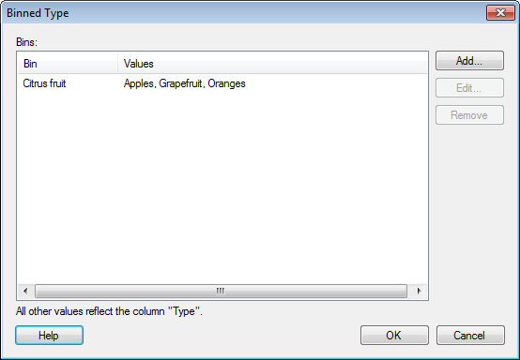
Bin methods
Based on Standard Deviation
Allows you to divide the range into sections as described by the selected standard deviation multipliers.
Substring
Allows you to group the values by the first or last characters in the column to be binned.
Values
Allows you to group values from the selected column into bins. Each added bin is listed, and so are the included values.

Slide 7
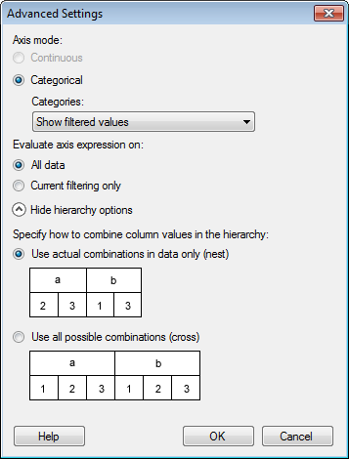
Advanced settings
Axis mode
Specifies whether the column or hierarchy should be treated as continuous or categorical.
Continuous
Select this option for numerical columns when you want the values to be treated as continuous, numerical values.
This option is not available for properties that are always categorical (like string columns).
Categorical
Select this option when you want the values to be seen as categories rather than numerical values.
For example, if you have the years 2001, 2002 and 2003 in a column, you would probably like to treat the different values as categories rather than numbers.

Slide 8
Advanced settings (categories)
Show filtered values
Select this option to display values available after current filtering only. This means that those categories that are visible will change with the filtering and that categories currently without any values will be hidden from the visualization.
Show filtered range
Select this option to hide empty categories on both ends of the currently visible range. This means that those categories that are visible will change with the filtering, and that empty categories within the currently visible range will remain visible.
Show all values
Select this option to keep all categories visible even if data for some categories have been filtered out.

Slide 9
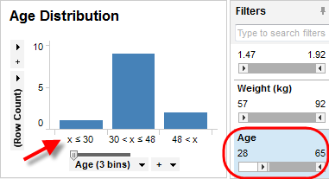
Advanced settings
Evaluate axis expression on...
All data
In the binning example above, the distribution of the available bins is calculated on the entire data volume. Filtering will not change the available bins on the axis, only the values therein:

Slide 10
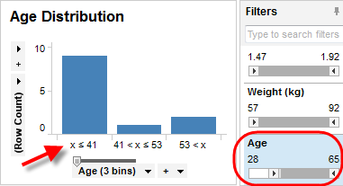
Advanced settings
Evaluate axis expression on...
Current filtering only
Using the same binning expression as above, filtering on Age will recalculate the available bins with new bin intervals for each filtering when this option is selected:

Slide 11
Advanced settings
Specify how to combine column values in the hierarchy
Specifies how many categories will be available, e.g., on an axis or in a list of colors in the legend.
Use actual combinations in data only (nest)
Use this option to display all combinations available in the data.
Use all possible combinations (cross)
Use this option to display all possible combinations, even showing categories that are currently not included in the data.

